Slide 1
CSE 2217: Data Structure and Algorithms-II
The Greedy Algorithmic Strategy

Slide 2
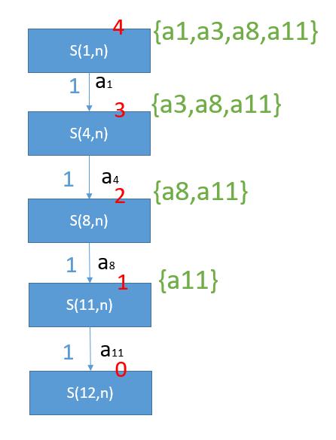
Key Takeaway From Previous Class
Greedy algorithm
The recursive function only makes one call with the best choice
Unlike dynamic programming where all the choices are explored
Hence no memorization is done here
If the data is provided to the algorithm in a suitable manner (for example by sorting in case of activity selection) then greedy will provide the optimal result
Since no branching in recursive tree we can write the code iteratively instead of recursively

Slide 3
ACTIVITY SELECTION AGAIN

Slide 4
Activity Selection
activity | a1 | a2 | a3 | a4 | a5 | a6 | a7 | a8 | a9 | a10 | a11
Start | 3 | 12 | 2 | 1 | 0 | 3 | 5 | 8 | 5 | 6 | 8
End | 5 | 14 | 13 | 4 | 6 | 8 | 9 | 12 | 7 | 10 | 11
Sort the activities by finish time.
Call the recursive function.
The recursive function selects the first activity
Then it calls another recursive function with the activities that do not overlap with the selected activity
This goes on until no activity is left
Obtain and print the result
Develop an iterative approach

Slide 5
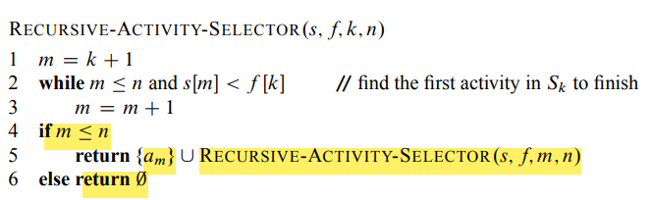
Recursive Pseudocode
Perform Manual Tracing
k , n

Slide 6
Activity Selection - Iterative
Already Sorted Activities (Otherwise we would be sorting again)
i
i
i
i
i
i
i
i
i
i
i | 1 | 2 | 3 | 4 | 5 | 6 | 7 | 8 | 9 | 10 | 11
start | 1 | 3 | 0 | 5 | 3 | 5 | 6 | 8 | 8 | 2 | 12
end | 4 | 5 | 6 | 7 | 9 | 9 | 10 | 11 | 12 | 14 | 16
k
k
k
k

Slide 7
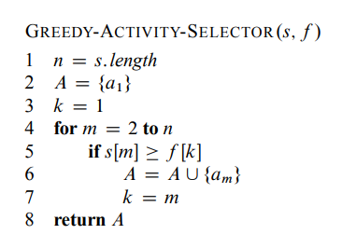
Iterative Pseudocode
Perform Manual Tracing

Slide 8
Why This Approach Works – Greedy Choice Property
The Approach we followed has greedy choice property.
How to prove that an approach has greedy choice property?

Slide 9
Greedy Choice Property
{aj ,ax , ay, az}
Let am be the activity that has
the earliest finish time.
S(1,n)
And we call the recursive function
S(1,n)
aj
…
We get a set of activities
{aj ,ax , ay, az}
…
THUS, there is no harm if
we make choices greedily.
We can still optimize
S(i,n)
If aj and am are the same activity,
Then great. It is as expected.
…
for this particular problem
However, if aj and am are different,
Then we can easily replace aj with am,
Because …
Thus , this problem has
Greedy choice property.

Slide 10
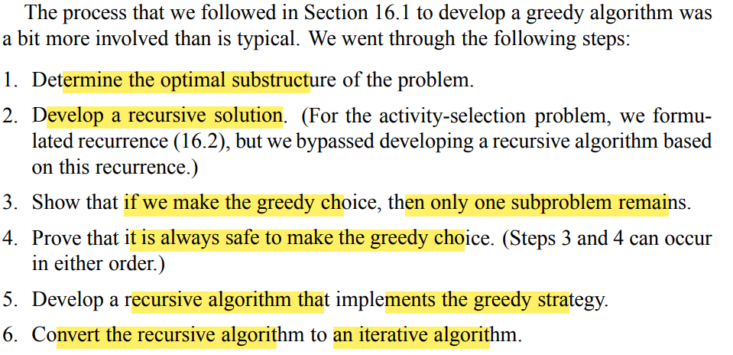
How we have tackled the last problem using the Greedy Approach
Prove that the problem has optimal
substructure property.
2. Develop a recursive solution.
3. Reframe the problem so that it
can be solved by greedy.
4. Prove that it has greedy choice
property .
5. Develop the recursive greedy algorithm
6. Develop the iterative greedy algorithm

Slide 11
However, the two most important things to consider when trying to solve a problem with greedy
Prove that the problem has optimal
substructure property.
2. Develop a recursive solution.
3. Reframe the problem so that it
can be solved by greedy.
4. Prove that it has greedy choice
property .
5. Develop the recursive greedy algorithm
6. Develop the iterative greedy algorithm

Slide 12
FRACTIONAL KNAPSACK

Slide 14
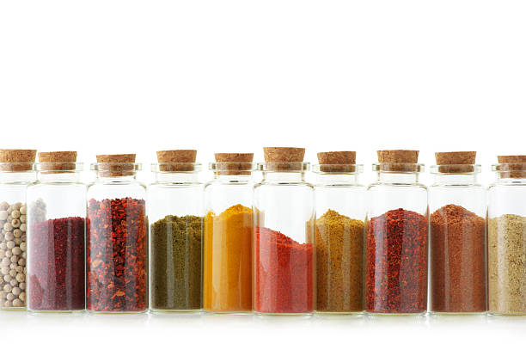
Fractional Knapsack
Given the weights and values of N items, put these items in a knapsack of capacity W to get the maximum total value in the knapsack. In Fractional Knapsack, we can break items for maximizing the total value of the knapsack
Basically we are teaching you now how to steal powdered spice,
with maximum profit of course!

Slide 15
Let’s See a Scenario
Objects
1
2
3
4
5
6
7
Prices
10
5
15
7
6
18
3
Weights
2
3
5
7
1
4
1

Slide 16
Let’s See a Scenario
Objects
1
2
3
4
5
6
7
Prices
10
5
15
7
6
18
3
Weights
2
3
5
7
1
4
1
P/W
5
1.6
3
1
6
4.5
3

Slide 17
Let’s see a scenario (sorted)
Objects
5
1
6
3
7
2
4
Prices
6
10
18
15
3
5
7
W=15
Weights
1
2
4
5
1
3
7
P/W
6
5
4.5
3
3
1.6
1

Slide 18
Let’s see a scenario (sorted)
Objects
5
1
6
3
7
2
4
Prices
6
10
18
15
3
5
7
W=15
Weights
1
2
4
5
1
3
7
2/3
W/Weight(i)
P/W
6
5
4.5
3
3
1.6
1
W=14
P=6
W=12
P=16
W=8
P=34
W=3
P=49
W=2
P=52
W=0
P=55.33

Slide 19
Greedy Fractional Knapsack
Alg.: Fractional-Knapsack (W, v[n], w[n])
while w > 0 and as long as there are items remaining
pick item with maximum v_{i}/w_{i}
x_{i} ← min (1, w/w_{i})
remove item i from list
w ← w – x_{i}w_{i}
w – the amount of space remaining in the knapsack (initially w = W)
Running time: Θ(n) if items already ordered; else Θ(nlogn)

Slide 20
The Two Properties
We need to use a recursive function
for the two properties
S(1,n,C)
S(1,n) will have the higher profit.
S(2,n,C-W[1])
If its sub problem(2,n) has higher profit.
S(3,n,C-W[2]-W[1])
…..
Hence there is optimal substructure property

Slide 21
Greedy Choice Property
{lj ,lx , ly, lz}
S(1,n)
And we call the recursive function
S(1,n)
lj
Since, lm is the most
expensive powder, it won’t
result in decrease of profit.
…
We get a set of items selected
{Ij ,Ix , Iy, Iz}
…
THUS, there is no harm if
we make choices greedily.
We can still optimize.
S(i,n’)
If Ij and Im are the same items,
Then great! It is as expected.
…
For this particular problem
However, if Ij and Im are different,
Then we can easily remove
the items from the container, making
Space for lm, and then inserting lm inside
Thus , this problem has
Greedy choice property.

Slide 22
HUFFMAN CODING

Slide 23
Huffman Coding
This is an efficient approach used for sending smaller sized characters.
Helps to make the transmission faster

Slide 24
Huffman Coding Process
Frequency Table Creation
First, analyze the data to be compressed (e.g., a text file) and create a frequency table listing each character and its occurrence count.
Building the Huffman Tree
Initialize a priority queue: Each entry in the queue is a tree node and includes a character, its frequency, and pointers to left and right child nodes. Initially, these nodes are leaf nodes for each unique character, with the frequency from the table.
Construct the tree: Repeat the following steps until the priority queue has only one node (the root of the Huffman tree):
Remove the two nodes of lowest frequency from the queue.
Create a new internal node with a frequency equal to the sum of the two nodes' frequencies.
Set the two nodes as children of the new node, one on the left and one on the right.
Insert the new node back into the priority queue.

Slide 25
EXAMPLES OF PROBLEMS THAT CANNOT BE SOLVED WITH GREEDY
0/1 knapsack
Coin Change Problem

Slide 26
Thank You

